Slide 1
Welcome To Vehicle Requisition Project
Developer Team – C

Slide 2
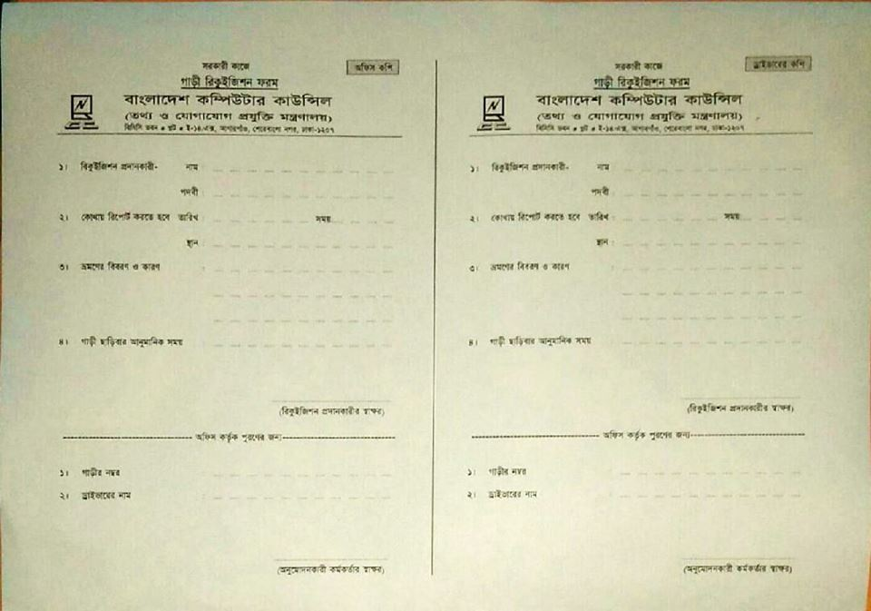
Goal of The System

Slide 3
Introduction
This requisition system for all of the employees of BCC. They can send request for vehicle of their various purposes. After Login Employee’s can submit a request to requisition. On the other hand Controller assign a vehicle on request. Also user or controller can cancel a request or delete request.
The present vehicle requisition system is manually. Which is taking a long time to process a requisition and assign a vehicle.

Slide 4
System Characteristics
The system need in web based and easy to use.
The system expected basic computer knowledge user to use. Such as user easily login into the system, send a request and view history.
The system provides time efficiency to show vehicle, user profiles, send a requisition and quick response from vehicle controller to assign a vehicle to an employee.
The system sends a notification to the user.

Slide 5
Role Based System Characteristics
System Controller:
System controller can add vehicle, add vehicle controller and employee.
Vehicle Controller:
Vehicle controller can approve requests, cancel or delete request.
Employee:
The employee can send a requisition, cancel a requisition and edit a requisition. Also check all requests from him/her.
Driver:
Driver need a notification in a mobile message if assigning a trip for him.

Slide 6
Overview of Functional Requirements
The user must be authenticated to log in and log out from the site. Once a user get into the site, they may do some operations. Such as, if a user login as an employee, He or She can submit requests, view request, cancel request, etc. In addition, they can search for certain information on request which is submitted from them and print the search result.

Slide 7
Functional Requirements
Authorized users must be able to login with their identification number or user name and password.
After a successful login the user only view and do an operation which is authorized by the system controller.
After the login user (Employee) may do some operations, Like- submit a request, view request, Delete or cancel the request, etc.
After the login user (Vehicle Controller) may do some operations, Like- approve a request, assign vehicle on request, cancel or delete request, etc.

Slide 8
Security System
Only Authorized user will be permitted to access the system. This system will provide the user’s with a secure way to change their password and personal information.

Slide 9
System Development Environment
Application Development:
DOT NET Platform
ASP .NET MVC 5
Entity Framework (Code first approach)
HTML-5, CSS-3 and Bootstrap 3
Java Script & JQuery- 2.4
Application Database:
Microsoft SQL Server -2012

Slide 10
User Stories
Back Log for System Controller
As a system controller I want to get user list. So that create a user list.
As a system controller I want to create vehicle list. So that create a option for vehicle entry.
As a system controller I want to create a driver list. So that create a option for driver entry.
As a system controller I want to create employee list. So that create a option for employee entry.
As a system controller I want to deactivate vehicle, Employee and driver. So that create a option for deactivate.

Slide 11
User Stories
Back Log for Employee
As a Employee I want to login. So that create login form.
As a Employee I want to search vehicle. So that create search option.
As a Employee I want to send a requisition for vehicle. So that create requisition form.
As a Employee I want to cancel requisition. So that create cancel button.
As a Employee I want to select vehicle and driver. So that create a option for select.
As a Employee I want to get a conformation message in mail or mobile. So that create a info option.
As a Employee I want to print requisition copy . So that create a print option.

Slide 12
User Stories
Back Log for Vehicle Controller
As a vehicle controller I want to requisition search option. So that create a requisition list.
As a vehicle controller I want to approve requisition . So that create a requisition approve field in list.
As a vehicle controller I want to cancel or delete requisition. So that create a option.
As a admin I want to reassign requisition. So that create a option.
As a vehicle controller I want to create check-in or check-out . So that create a option.
As a vehicle controller I want to send conformation mail or message to employee and driver. So that create conformation info.

Slide 13
Use case Diagram
Log In
Vehicle Controller
Add Vehicle, Controller & Employee
System Controller
Requisition
Requisition Search
Employee
Check In
Check Out
Cancel Request
Re-Assign
Driver
Notification

Slide 14
VehicleType Entry Form (System Controller)
Object: VehicleType
Attribute
Id;
TypeName;
Description;
Activity:
CreateType();
EditVehicle();
Detais();
Delete();
TypeList();
Title | Text Box
TypeName*
Description

Slide 15
Vehicle Entry Form (System Controller)
Object: VehicleEntry
Attribute
Id;
VehicleTypeId;
RegNo;
Description;
DriverId;
IsDelete;
Activity:
Create();
Edit();
Detais();
Delete();
List();
Title | Text Box
VehicleType*
Registration No*
Driver
Description

Slide 16
Driver Entry Form (System Controller)
Object: DriverEntry
Attribute
Id;
Name;
LicenseNo;
MobileNo;
NID;
Address;
IsDelete;
Activity:
Create();
Edit();
Details();
Delete()
List();
Title | Text Box
Name
Mobile No
License No
NID
VehicleName
Address

Slide 17
Employee Designation Form (System Controller)
Object: EmployeeDesisgnation
Attribute
Id;
Designation;
Activity:
Create();
Edit();
Details();
Delete();
List();
Title | Text Box
Designation
Description

Slide 18
Employee Entry Form (System Controller)
Object: Employee
Attribute
Id;
Name;
DesignationId;
Email;
ContactNo;
Address;
Activity:
Create();
Edit();
Details();
Delete();
List();
Title | Text Box
Name
Designation
Email
Mobile No
Office Address

Slide 19
Requisition Form (Employee)
Object: Requisition
Attribute:
Id;
Employee;
JourneyStartDateTime;
JourneyEndDateTime;
SetCapacity;
JourneyFrom;
JourneyTo;
JourneyDescription;
Activity:
RequisitionList();
SearchRequisition();
SendRequisition();
CancelRequisition();
EditprofileInfo();

Slide 20
Vehicle Controller Form
Object: Requisition
Attribute:
Requisition;
Driver;
Vehicle;
CheckIn;
CheckOut;
Activity:
RequisitionList();
AddVehicle();
AddDriver();
ApproveRequisition();
CancelRequisition();
Re-Assign();
CheckIn();
CheckOut();

Slide 21

Employee View Diagram
Dash Board
Hi! user@mail.com
Logout
My Profile
Home > Dash Board
Requisition
Personal Info
Name: Chitto Ranjan Sarker
Cell: +8801714863917
Email: chittoranjan.sarker@gmail.com
Gender: Male
My Request
Vehicle Search

Slide 22
Employee View Diagram
Dash Board
Hi! user@mail.com
Logout
My Profile
Home > My Profile
Requisition
Personal Info
Name: Chitto Ranjan Sarker | Department: BKIICT
Cell: +8801714863917 | Address: Mohammadpur, Dhaka.
Email: chittoranjan.sarker@gmail.com
Designation: Programmer
My Request
Vehicle Search
Update

Slide 23
Employee View Diagram
Dash Board
Hi! user@mail.com
Logout
My Profile
Home > Update
Requisition
Browse
My Request
Personal Info
Name: Chitto Ranjan Sarker | Department: BKIICT
Cell: +8801714863917 | Address: Mohammadpur, Dhaka.
Email: chittoranjan.sarker@gmail.com
Designation: Programmer
Vehicle Search
Update

Slide 24
Employee View Diagram
Dash Board
Hi! user@mail.com
Logout
My Profile
Home > Requisition
Requisition
Send Requisition
My Request
Vehicle Search
Send

Slide 25
Employee View Diagram
Dash Board
Hi! user@mail.com
Logout
My Profile
Home >My Requisition
Requisition
Requisition List
My Request
Vehicle Search

Slide 26
System Controller Diagram
Dash Board
Hi! user@mail.com
Logout
Add Vehicle
Search
ADD Driver
Add Employee

Slide 27
Vehicle Controller Diagram
Dash Board
Hi! user@mail.com
Logout
Requisition List
Search
Driver List
Employee List
Check In
Check out

Slide 28
System Developer
Team Leader:
Md. Enamul Haque
Team Members:
Md. Masum Bella
Mst. Luthfunnesa Sultana
Mst. Benjeer Haque
Chitto Ranjan Sarker

Slide 29
Thanks To All

